Slide 1

SOLID PRINCIPLES
Tenacious​

Slide 2

SOLID PRINCIPLES
Tenacious ​
The 5 principles of SOLID are:
Single responsibility principle-A class should only have a single responsibility, that is, only changes to one part of the software’s specification should be able to affect the specification of the class
Open closed principle-Software entities should be open for extension, but closed for modification.
Liskov substitution principle-Objects in a program should be replaceable with instances of their subtypes without altering the correctness of that program.
Interface segregation principle-Many client-specific interfaces are better than one general-purpose interface.
Dependency inversion principle-One should depend upon abstractions, [not] concretions.

Slide 3
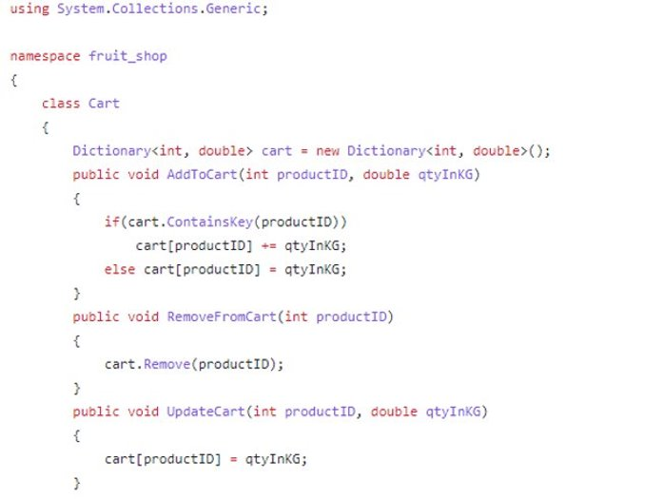
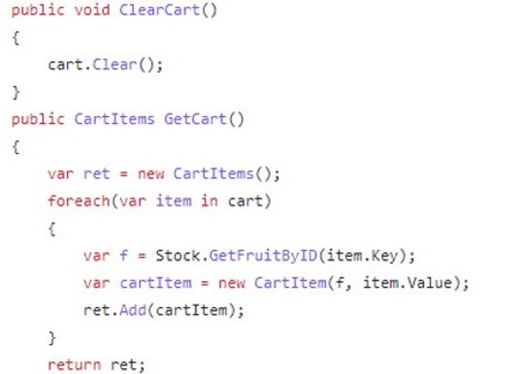
Single Responsibility
Tenacious ​

Slide 4
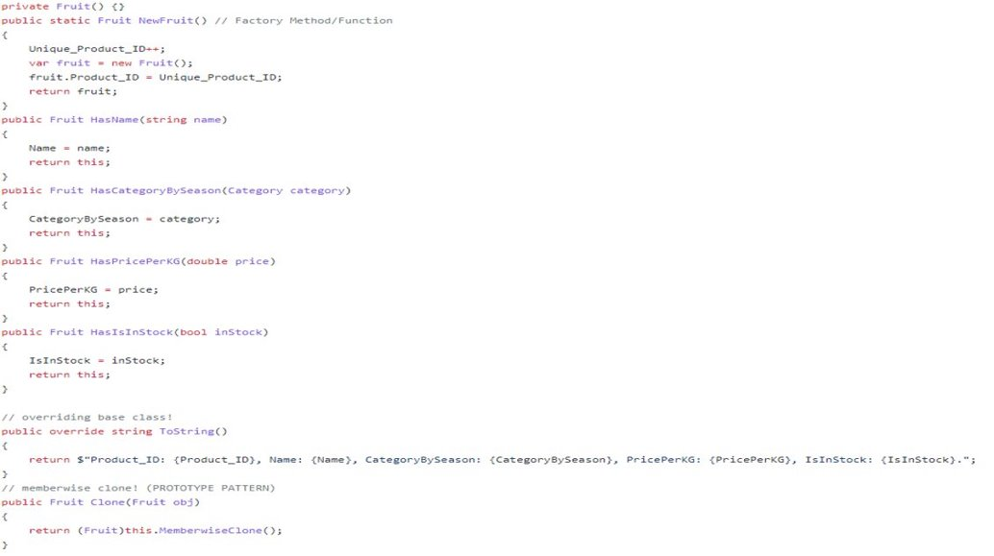
Open Closed
Tenacious ​

Slide 5
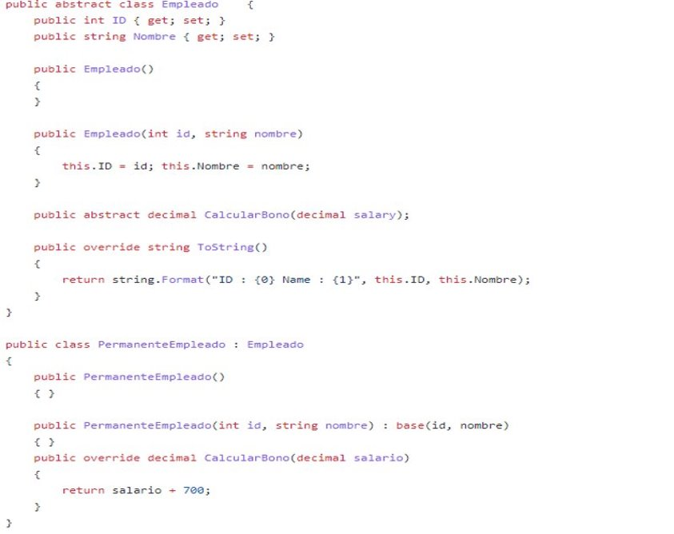
Liskov Substitution Principle
Tenacious ​

Slide 6
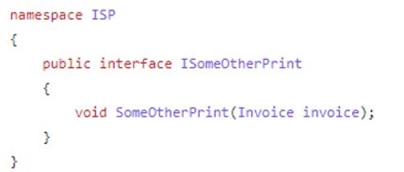
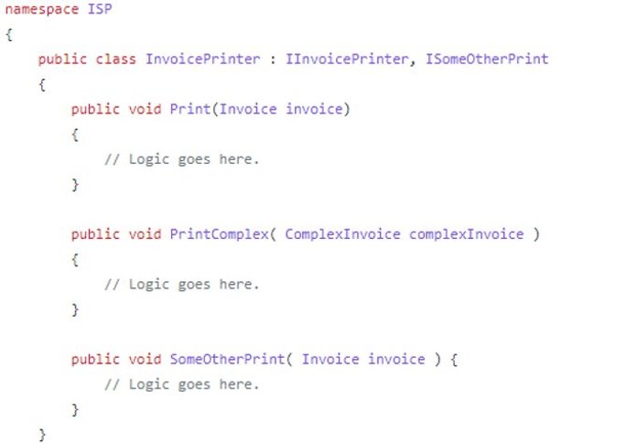
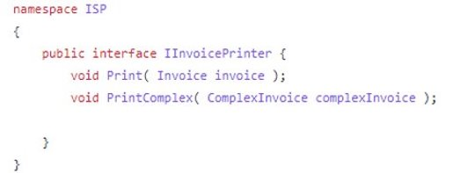
Interface Segregation
Tenacious ​

Slide 7
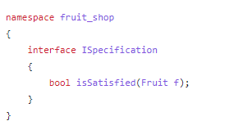
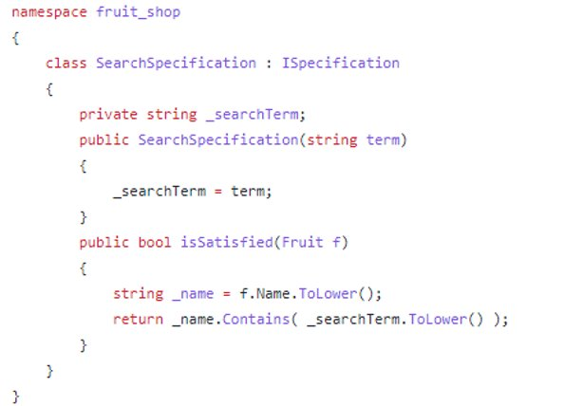
Dependency Inversion /injection
Tenacious ​
Parent Class :
Child Class :

Slide 8


